Slide 1

Dashboard Executive Summary
Everett Johnson

Slide 2
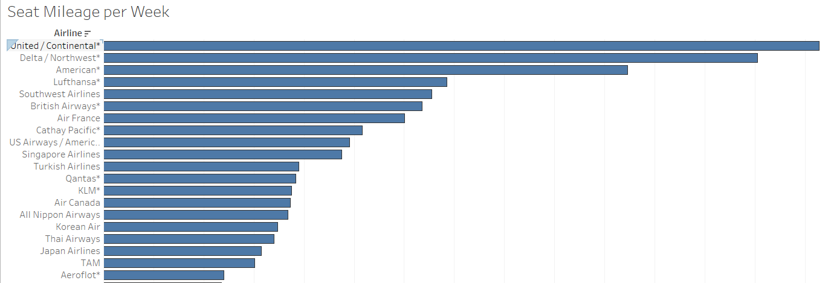
Airplane Mileage by Carrier

Slide 3
Flight Safety
Is it truly safer to fly rather than use other forms of travel for customers?
According to Flyfright.com, “ There is a 1 in 3.37 billion chance of dying in a commercial airline crash between 2012 and 2016”
Of the 140 crashes that took place during this time frame, only 2 involved fatalities
Reference: https://flyfright.com/statistics/

Slide 4
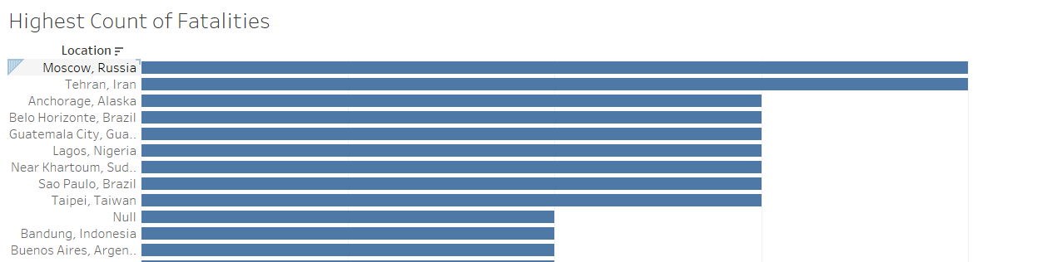
Highest Number of Fatalities By Country

Slide 5
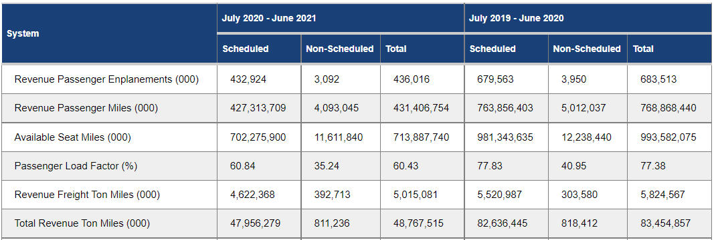
Passenger Data over the Past Year https://www.transtats.bts.gov/TRAFFIC/

Slide 6
Why Airlines and Air Travel is safe
Technology
Regulations
Training
Checks and Balances
Air travel resulted in 0.07 deaths for every 1 billion miles travelled compared to 212.57 for motorcycles and 7.28 for cars. We will continue to make the skies safer and you continue to fly!
Reference: https://www.sheffield.com/air-travel-safest-mode-transportation

Slide 7
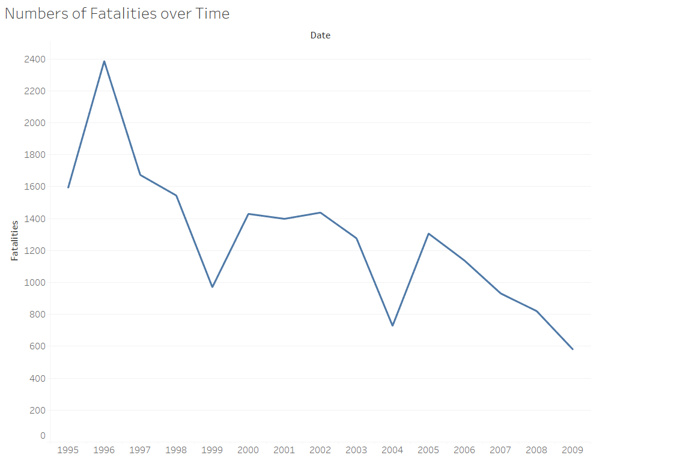
Fatality Trend Over Time

Slide 8
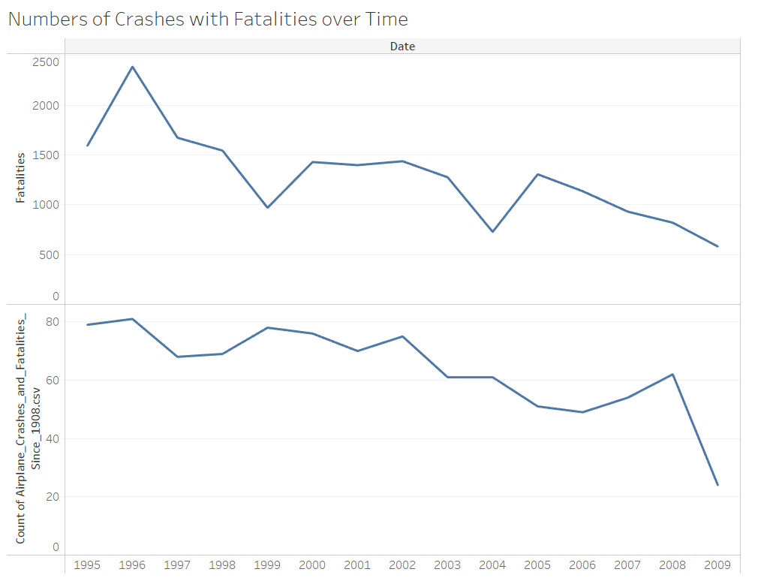
Fatalities Versus Crashes

Slide 9
References:
Morris, E. (2021, April 6). Why Air Travel is the safest mode of transportation? Sheffield School of Aeronautics. Retrieved October 8, 2021, from https://www.sheffield.com/air-travel-safest-mode-transportation.
General. U.S. Air Carrier Traffic Statistics. (n.d.). Retrieved October 8, 2021, from https://www.transtats.bts.gov/TRAFFIC/.
D. S. (2020, April 16). Plane Crash Statistics: What are your chances of dying on a Flight? FlyFright. Retrieved October 8, 2021, from https://flyfright.com/statistics/.
Github:

